Slide 1
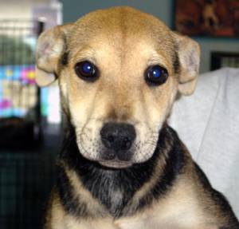
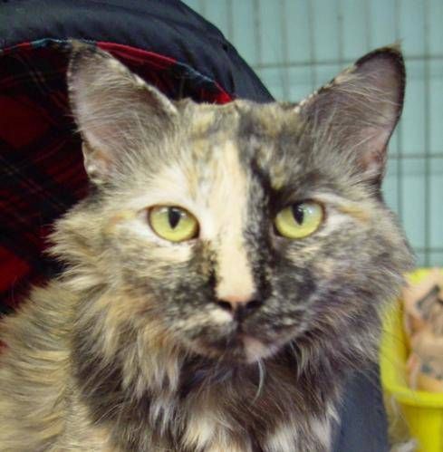
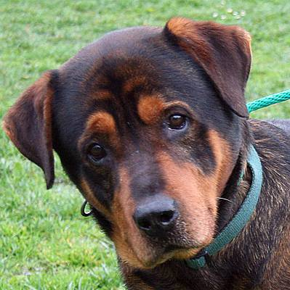
One Hot Vector Example:
Let’s say we have 3 images, then they can be represented by the following one-hot vector representation
[1,0,0]
[0,1,0]
[1,0,0]
https://www.kaggle.com/c/dogs-vs-cats/data

